Slide 1
Second Life
Nikki Beckett: nmbeckett

Slide 2
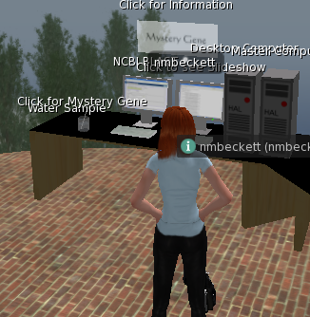
Hypothesis: I can use this computer to access the internet.
Link: http://maps.secondlife.com/secondlife/Genome/140/216/61

Slide 3
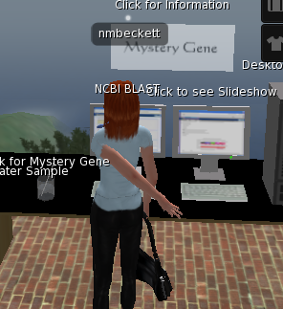
Hypothesis Wrong! Clicking on the computer did nothing. I was only able to change the image on the screen.

Slide 4
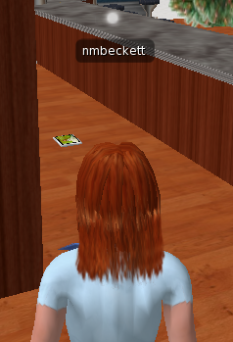
Hypothesis: I will be able to pick up the item on the floor.
LINK: http://maps.secondlife.com/secondlife/Xenia/158/53/25

Slide 5
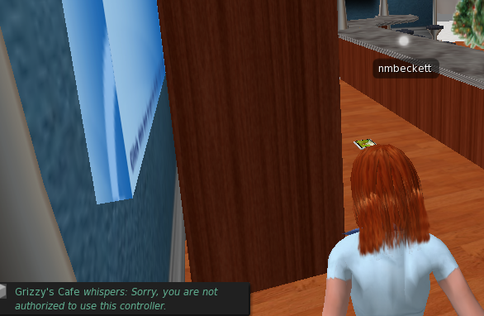
Hypothesis Wrong! I was unable to pick up the item on the floor.

